Slide 1

Unit 12

Slide 2
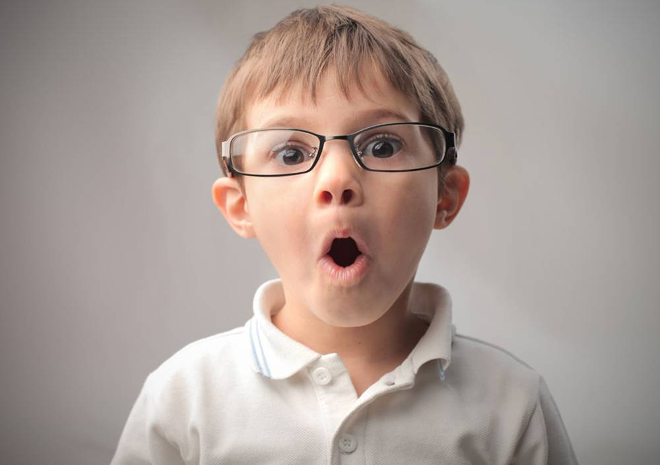
Unit 12
Life is full of the unexpected.

Slide 3



Slide 4


Fill in the blanks with the correct forms of the words or phrases.
rush realize invite show up stay up
I was waiting for the school bus but it didn’t come. Then I ________ it was Saturday.
2. I woke up late this morning. I had to
really ______ to get to school on time.
realized
rush

Slide 5
rush realize invite show up stay up
3. There’s a good TV show tonight but
it’s at 1:00 am. I don’t want to _________ that late.
4. Sally _______ me to her birthday party. It’s at her house on Saturday.
5. Do you know where John is? He was
going to meet me earlier but he didn’t
_________.
stay up
invited
show up

Slide 6


1. To understand the stories about fooling others
2. To be able to do some exercises after reading the passage
3. To learn some words and expressions

Slide 7




Have you ever played jokes on others,
especially on Aril Fool’s Day? Have
you ever been fooled by others? Tell
your story to your partner.
2a

Slide 8
April Fool's Day is a traditional day to play jokes on others. No one knows how this holiday began but it was thought to have started in France.
传统上来讲，愚人节这一天，人们可以相互搞恶作剧。没人知道这个节日是怎么来的，但人们普遍认为它源自法国。

Slide 9
In the 16th century, people celebrated New Year's Day from March 25 to April 1. In the mid—1560s King Charles IX changed it from March 25 to January 1. But some people still celebrated it on April 1, so others called them April Fools.
16世纪时，法国新年是在3月25日，一直持续到4月1日。到了60年代中期，国王查理九世把新年从3月25日变为1月1日，而还有一些人在4月1日过新年，这些人就被称作四月傻瓜了。

Slide 10


Read the passage quickly. Then answer the question:
How many stories are mentioned in this passage?
Four

Slide 11
Read the passage quickly. Then match each paragraph with the main idea.
2b
Paragraph 1
Paragraph 2
Paragraph 3
Paragraph 4
◆ One of the most famous tricks played
◆ Examples of funny stories that happened on April Fool’s Day
◆ An introduction to April Fool’s Day
◆ A sad story that happened on April Fool’s Day

Slide 12
Read the last story, and complete the form.
When | Who | What | Result
He announced on his radio program that aliens from Mars had landed on the earth.
By the time police officers announced that the story was a hoax, thousands of people had left their homes.
October, 1938
Orson Welles

Slide 13

Read the passage again and
answer the questions.
2c
1. Why did the supermarkets run out of spaghetti one April Fool’s Day?
n. 意大利面条
A reporter announced that there would be no more spaghetti because spaghetti farmers in Italy had stopped growing spaghetti.
v.宣布；宣告

Slide 14
2. What did the TV show say the special
water could do?
3. Why did the TV star’s joke have a bad
ending?
It was said that the special water would help people lose weight.
He lost both his girlfriend and his show.

Slide 15
4. When did Orson Welles tell people about aliens from Mars landing on the earth?
5. Why did so many people believe Orson Welles?
It was in October 1938.
Orson Welles made it sound so real that hundreds of people believed the story.

Slide 16
6. Which of these stories is the most
believable? Which is the least believable?
Why?
7. Would you be fooled by any of these stories?
I think the story of a famous movie star is the most believable. The story of aliens from Mars is the least believable. Because the movie star is living with people. People never see any aliens on the earth.
adj.可相信的；可信任的
Open.

Slide 17
Close your books and complete the blanks.
April Fool’s Day
When: On April 1st
What: Many people play all kinds of tricks and jokes on each other.
Funny stories
A sad story
A famous trick

Slide 18
Funny stories
One hoax is about spaghetti. A reporter said the Italian farmers had ____________________.
Another is about special water. They said the water could help people _____________.
stopped growing it
lose weight

Slide 19
A sad story
A famous TV star made a joke on _____________, and as a result, he lost her and his show was canceled.
his girlfriend

Slide 20
A famous trick
It happened in __________.
The actor Orson Welles announced on his radio program that aliens from Mars had landed on the earth. Many people believed him and _________________.
October
left their homes

Slide 21
Fill in the blanks with the correct forms of the verbs in brackets.
2d
1. After the spaghetti story __________
(appear) in the news, everyone _______
(rush) to the supermarkets.
2. By the time people ________ (find out)
the story was not true, all the spaghetti
in the supermarkets _______________
(disappear).
appeared
rushed
found out
had disappeared

Slide 22
3. By the time the day ______ (end), more
than 10,000 people _________ (call) the
TV station to ask about the special water.
4. By the time the show _____ (end), the TV star ________ (lose) his girlfriend.
5. By the time police officers ____ (tell)
the country that the story was a hoax,
many people ____________ (run away)
from their homes.
ended
had called
ended
had lost
told
had run away
n. 骗局；恶作剧

Slide 23

Tell your funny story from 2a to
the class. The class will vote for:
2e
a. the funniest joke
b. the most embarrassing joke
c. the most creative joke
adj. 使人害羞的（难堪的或惭愧的）

Slide 24
A: What’s your story?
B: Well, last year, on the first day of school, my sister put a piece of paper on my back that said “Please say hello”. All morning at school…

Slide 25


take place
local supermarkets
sell out
lose weight
find out
end up doing sth.
get married
cancel his show
hundreds of
thousands of
police officers
发生
当地的超市
卖光
减肥
弄清；查明
以做某事告终
结婚
取消他的节目
成百上千的；数以百计的
成千上万的；数以千计的
警官

Slide 26


Ⅰ. 根据句意及括号内所给单词的提示填空。
1. It rained heavily yesterday, so Mr. Trent _________(cancel) his travel to Qingdao.
2. The government has __________(announce) that 10,000 new jobs will be offered next year.
3. The party lasted for 3 hours, and then the _________(lady) left, but the men continued to drink and talk.
canceled
announced
ladies

Slide 27
4. To do their jobs better, nurses, doctors, or police _________(officer) need to speak more than one language.
5. The scientist has made another wonderful _________(discover). I think it is very important to science development.
officers
discovery

Slide 28
Ⅱ. 根据语境，从方框中选择恰当的短语填空，有的需要变换形式。
sell out, find out, end up, get married, take place, lose weight, thousands of
1. It's hard for Nancy to ________________ because she has a sweet tooth (喜欢吃甜食).
2. The fried chicken made by them tasted delicious and was soon ________________.
lose weight
sold out

Slide 29
sell out, find out, end up, get married, take place, lose weight, thousands of
3. The sports meet was supposed to ______________ on Sunday, but was put off because of the storm.
4. Mark has become a famous scientist. When he was a child, he liked to ________________ how things worked.
5. —Did you go to Sanya for your holiday?
—No, we couldn't get tickets for Sanya so we _______________ going to Qingdao instead.
take place
find out
ended up

Slide 30
sell out, find out, end up, get married, take place, lose weight, thousands of
6. The natural scenery in my hometown attracts
(吸引) ________________ foreign visitors every year.
7. At the age of twenty-four, Kate fell in love with Bob. Two years later, they ________________.
thousands of
got married

Slide 31


1. Review the new words and expressions you’ve learned today.
2. Preview 3a-3b on P95 - P96.

Slide 32


